Slide 1




Real-time Smart Reactions in Virtual Meets
A Computer Vision Project

Slide 2
DSN 2099 - Project Exhibition - II - Final Review
Guided by:
Dr. Paras Jain, Senior Assistant Professor,
SCSE, VIT Bhopal University
Submitted by:
Indrashis Paul, 19MIM10046
Raghav Agarwal, 19MIM10024
Shobhit Vatsya, 19MIM10040

Slide 3

Introduction
Below we have introduced our Project idea, the problem statement we are addressing and the solution that we have proposed.

Slide 4
Virtual meetings are hyped up in this new normal. While attending any online conference/ lecture, it is quite difficult to mute and unmute time and again for small reactions, especially when someone else is speaking.
We have to unmute ourselves and interrupt the speaker in the process, even for small reactions like- ‘yes’, ‘no’, ‘Hi’, ‘I have a question’, ‘Boring’, ‘Funny’ etc. This problem can be smartly solved using Computer Vision.
Our idea is to train a Hand Gesture Recognition model and to use its result(s) as an input for the virtual meeting application to show smart reactions based on the recognized hand gestures.

Slide 5

Literature Review & Existing Works
In August, 2014, Zoom first added the “Raise Hand” feature during a meeting where the participants can simulate raising a hand in virtual meetings using a clickable emoticon. It was followed by further enhancements to the raise hand feature and the addition of support for emojis in group messaging [1].
On February 28, 2017, Zoom added and enhanced the non-verbal feedback feature. During a presentation, participants can provide non-verbal feedback without interrupting the flow of the presentation. Participants have the ability to raise their hand, signal yes or no, indicate to go faster or slower, and use emojis.
In June, 2020, Microsoft Teams and on Nov, 2020, Google Meets also added the “Raise Hand” feature using a clickable icon. This was a great improvement to their respective platforms but no Participant was able to express their emotions during a virtual meet unlike Zoom. MS Teams [Raise hand in Teams meetings - Microsoft Teams | Microsoft Docs] Gmeet [Hand Raising with Google Meet - Computer - Google Meet Help] [2] [3]

Slide 6
On August 4, 2020, additional meeting reactions were added to Zoom meetings. In addition to the clapping and thumbs up reactions, meeting participants could then react with a heart, surprised face, laughing face, or party emoji. Those receiving the reactions would also have needed to have the latest version of the Zoom client to see them.
On December 10, 2020, Microsoft Teams publicised their release of a new version with “Live Meeting Reactions” in addition to the “Raise Hand” feature using clickable emoticons and live animations depicting the respective emotions. Since then MS Teams had 4 exclusive emoticons for Meeting reactions. The Meeting Reactions feature allows users to choose from four different reaction types – like, love, applause, and laugh. Users can click on a reaction to send it to the meeting. Participants in the meeting will see the reaction over the user's position on the meeting stage, and the user will also see the reaction displayed on the user’s "ME" box at the lower right of the meeting stage. [4]

Slide 7
On December 21, 2020, Zoom meetings enhanced their nonverbal feedback and reactions. Nonverbal feedback options were moved to the Reactions button, and all reactions would have been shown in the corner of the participants’ video. The host would see each participant’s reactions in the participant list, as well as the aggregate numbers of each reaction at the bottom of the list. [5]
On April 19, 2021, Zoom meetings added a full emoji suite for Non-verbal reactions during a meeting. Any emoji available for Zoom chat can be used as a reaction in a meeting. The host can also restrict reactions to the standard set, or allow use of the full emoji suite. This is the latest update of Meeting Reactions in any major platforms. [6]

Slide 8

Proposed Work and Methodology
Below we have briefed about the methodology we are adopting to solve the aforementioned problem.

Slide 9
Proposed work is to find and develop a real-time solution of the above stated problem statement by using a Hand Gesture Recognition model to classify the input video stream into the desired number of classes (like- ‘yes’, ‘no’, ‘Hi’, ‘I have a question’, ‘Boring’, ‘Funny’ etc ).
Overall steps involved in the process are as follows:
Building a Hand Gesture Recognition model.
Using the above model to classify and recognize hand gestures from the input video stream.
Mapping the recognized hand gestures to their respective smart reactions.
Using the above obtained reactions as an input for OBS(Open Broadcaster Software)[7].
Enabling the virtual camera option in OBS.
Changing our input video source from default webcam to OBS virtual camera in the online meeting platform (In our case - Zoom).

Slide 10
Video Processing
Hand Gesture Recognition Model
Mapping Gestures to Smart Reactions
Recognized Hand Gestures
Augmented Video
Raw Data
Using the reactions as input to OBS
Smart Reactions in Virtual meets
Changing the input video source to OBS
Enabling Virtual Camera option in OBS

Slide 11

Novelty of the Project
Below we have discussed how our proposed methodology is a novel approach towards solving the aforementioned problem statement.

Slide 12
There are lots of emoji reactions available in virtual meeting applications but for sending those, we have to select a reaction by clicking over the emoticons.
Instead of leaving the stickers or emoji in the chat, we can directly display the emoji filters along side the users’ real-time video.
All we need is to show the hand gestures in front of the camera to express our reactions and this can be done without interrupting the flow of the meeting.
It will really add to the interactivity of the meetings and will be loved by the attendees too.

Slide 13

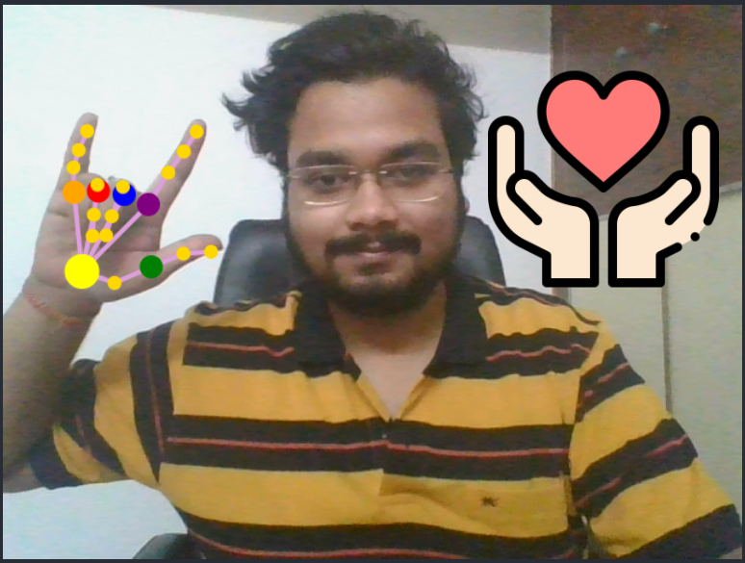
Real - Time Usage
Below we have discussed how our proposed methodology can be used in Real-time applications

Slide 14
This solution could be very helpful in this new normal where online meetings and virtual education is essential.
We can use this solution in any online meeting- lectures, classes, seminars, meetings, conferences etc.
One very interesting use-case is for using sign language. For the people who can not speak, it's very hard to communicate with other people as most of the time the other party does not know the sign language. But, with this innovative technology, they can communicate very easily. We just have to make some custom gestures and let our machine understand them. The person can show their sign, which is ofcourse a hand gesture in front of the camera, our model will detect the sign made by that hand gesture and will display an appropriate emoji to the other users in the meeting.

Slide 15
Hardware Requirements
Software Requirements
A Desktop or a Laptop with:
RAM - At least 4GB
External or Internal Webcam
Secondary Memory - At least 1.5GB of Disk Space and 700MB of Virtual Memory
CPU - Quad core Intel Core i3 or higher
Optional: Graphic Card
For Application Use:
Open Broadcaster Software (OBS)
Any virtual meeting application like zoom meetings.
For training and developing solution (including the above mentioned):
Python 3.6 or higher/ JS/ React
VS Code and Jupyter Notebook

Slide 16

Model Architecture
We have provided the total ideated model structure and functions below.

Slide 17
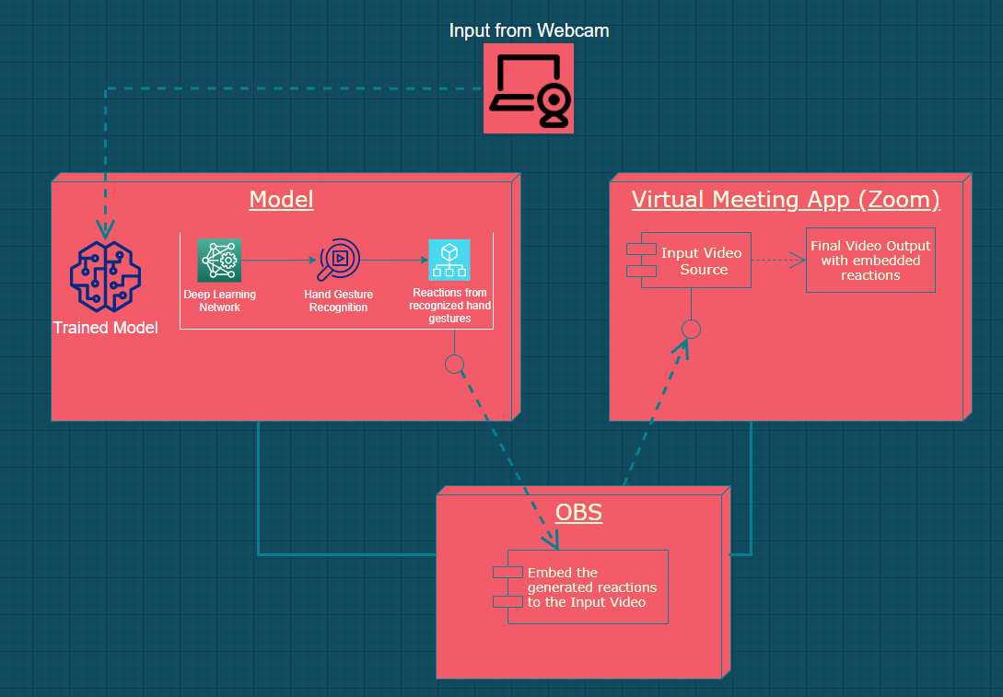

Slide 18
Module Description
Our entire workflow has been divided into following modules:
Data Collection:
Hand Gesture image dataset of size ~2GB from Kaggle.
Hand Gesture Recognition using self trained model (Python)
Training Deep Learning model: Building and training a Deep Learning based model to classify hand gestures.
Real-Time Hand Gesture Recognition: Recognising the gesture shown by the hand out of the entire image frame using the trained model.
Hand Gesture Detection and Recognition using Posenet and fingerpose.
Hand Pose Estimation: Estimation of Hand Pose and drawing a mesh over the detected state of hand in real time.
Hand Gesture Recognition: Classifying the gesture into the desired class.

Slide 19
Mapping Gestures with Smart reaction emojis:
Mapping the classified gestures with sensible emoji and displaying them on the output video.
Smart Reactions in Zoom meetings:
Projecting the output video as an Input video for Zoom video app using OBS.

Slide 20
Module workflow explanation:
Data Collection:
The data we used for training our model is taken from Kaggle. The database is acquired by LeapMotion and the kaggle link for the same is: Hand Gesture Recognition Database | Kaggle
We used the kaggle API for downloading the dataset:
Created a folder “.kaggle” which contains the “kaggle.json” file with our kaggle account API reference.
Installed the kaggle API using “pip” to gain access to kaggle api commands.
Searched for the exact name of the database within various datasets.
Used the given name to extract and download the dataset into folders.
Unzipped the folder for further use.

Slide 21
2. Hand Gesture Recognition using Self-trained Model (Python)
Training a CNN based model for Gesture Recognition:
Imported the required dependencies including Keras running on TensorFlow backend and others.
Preprocessed the collected data - Reshaped the image array, rescaled them between a range of 0 and 1 and then split them into train and test sets
Built a CNN model with the proper filters and input dimensions which can fit over the training data and evaluate on the testing data. (Details are included in the Code Walkthrough)
3 Convolutional 2D layers each followed by a Max Pooling 2D layer.
A Flatten layer to squeeze the 2D output into a 1D vector.
A Fully connected Dense layer with relu activation.
An output Dense layer with softmax activation for final Classification.
Saved the model as a “.h5” file

Slide 22
Real-Time Hand Gesture Recognition:
Imported the required dependencies including OpenCV for video input.
Used the WebCam for capturing video input frame-by-frame
Preprocessed the Input data from video - Converted to GrayScale, reshaped the image array, rescaled them between a range of 0 and 1 and used them for predictions.
Feeding the preprocessed input video data (frame-by-frame) into the trained model for prediction of classes.
Displaying the resulting output on the output screen as per prediction.

Slide 23
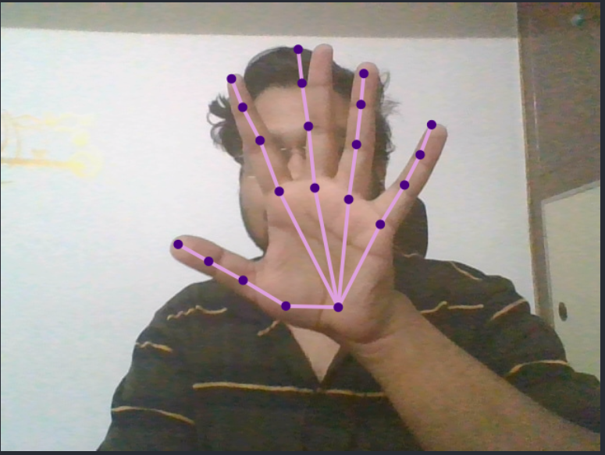
3. Using JavaScript and React:
Installing required libraries-tensorflow.js, handpose model*[8], react-webcam.
Importing above dependencies.
Setting up the webcam and the canvas.
Creating references of the webcam and the canvas.
Loading Handpose.
Feeding webcam input into the model.
Storing the output given by the model.
The output will be in form of an array which will consist of the 3D coordinates of the positions of the 21 keypoints across the hand.
Drawing mesh around the hand.
*Handpose is a lightweight ML pipeline consisting of two models: A palm detector and a hand-skeleton finger tracking model. It predicts 21 3D hand keypoints per detected hand

Slide 24
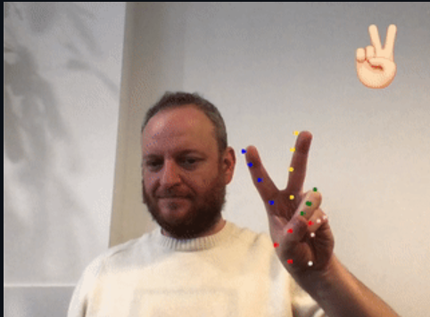
Hand Gesture Recognition using fingerpose[9]:
Gesture detection works in three steps:
Detect the hand landmarks inside the video picture.
Estimating the direction and curl of each individual finger.
Comparing the result to a set of gesture descriptions.
First step is performed using TensorFlow “handpose”, the other two
steps are done by this library.
Main substeps in this module are:
Installing fingerpose - npm install fingerpose
Importing emojis and fingerpose
Importing the images
Updating the above written detect function for gesture handling
Adding emoji image to the display screen

Slide 25
In our project we have used 5 gestures, namely- ‘thumbs-up’, ‘thumbs-down’, ‘victory-sign’, ‘love’, ‘palm raised’.
Among these, only two gestures are predefined- ‘thumbs-up’ and ‘victory’.
Rest gestures are manually custom made by us using the gesture description provided by fingerpose.
We have created a sign language gesture- ‘i love you’, which can be very useful for people who can not speak.
For creating this we have given curl and directions of all 5 fingers, which can be found in the github repository- here.

Slide 26
Deployment
We have deployed our project into github using ‘gh-pages’. The detailed steps for deployment can be found here.
And our deployed project can be found here.

Slide 27
Smart Reactions in Zoom
Smart Reactions in Zoom meetings:
For this, we have used an open source software called “Open Broadcaster Software.
Firstly, we installed the OBS from here and Zoom meetings app from here.
After that, we can open our deployed project. Once the project is running smoothly we can create a window capture in OBS and capture the browser window in which the react app is running. Once our scene in OBS is ready we can enable the ‘virtual camera’ option in OBS. Now we just have to create a new meeting in the zoom app and select - ‘virtual camera’ as an input for the video.

Slide 28
Implementation and Coding
Implementation and coding can be found in following links:
https://github.com/imraghavagr/deploytest
https://github.com/IndraP24/Sem-4-Project-Smart-In-Meeting-Emoji-Reactor

Slide 29
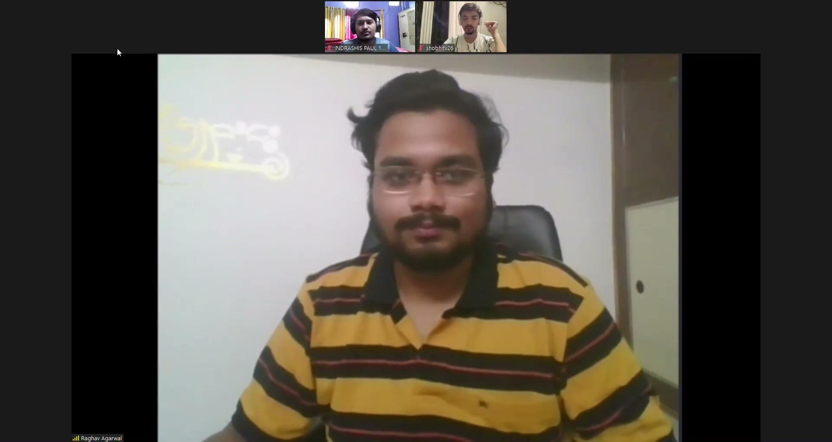
Demo Video

Slide 30
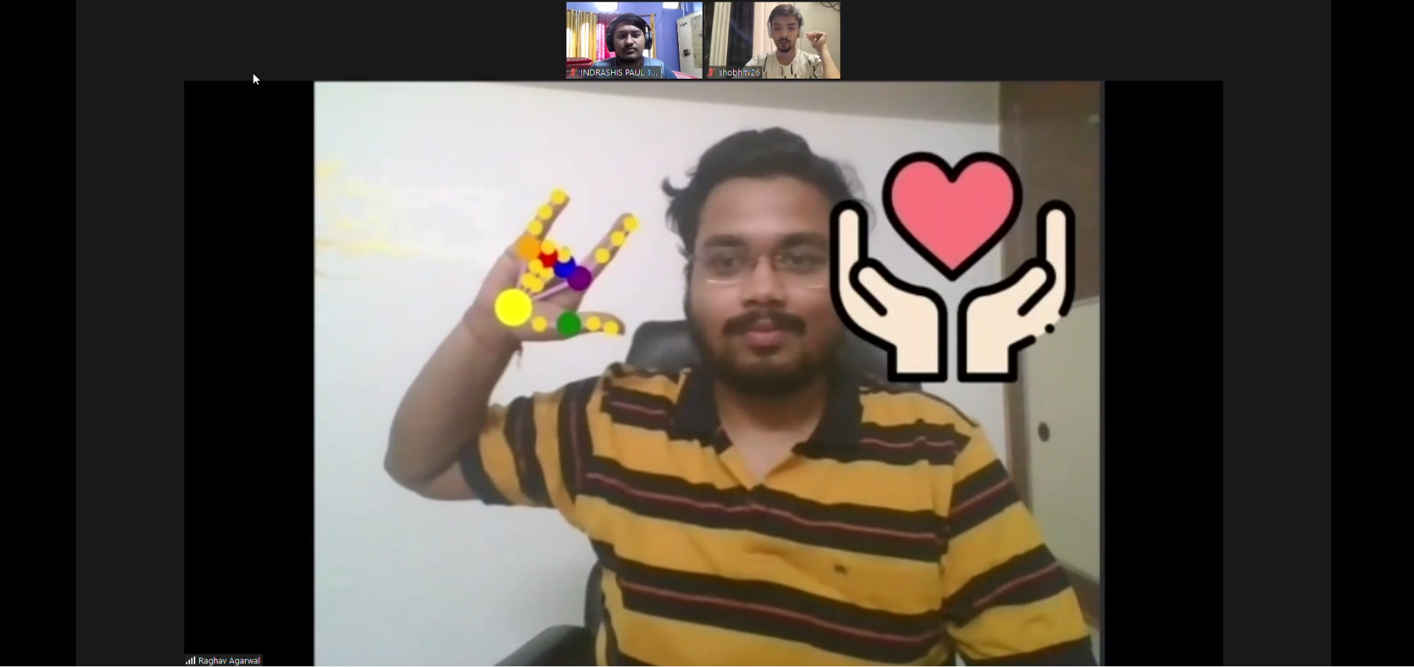
Snapshot of
Project

Slide 31
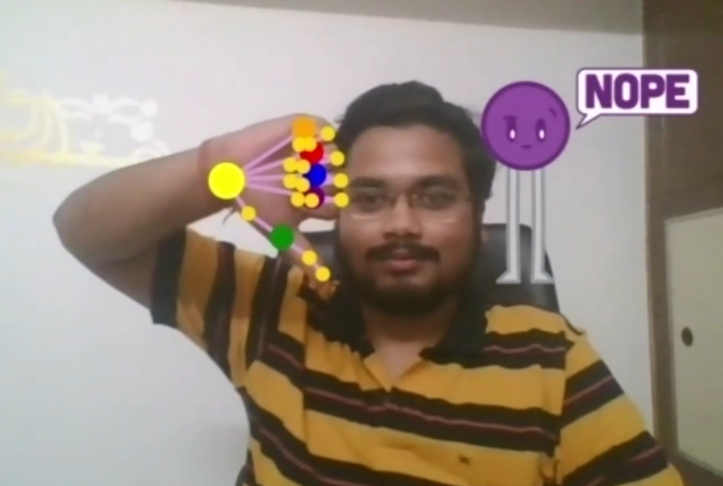
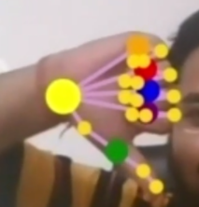
Result
Input
Output

Slide 32
Discussion
With input as our hand gestures, we are getting the mapped emoji alongside the video which will serve the problem statement of this project. Also, We can add more number of custom gestures in the app by which people with speaking and hearing disabilities can easily communicate via our app in live meetings.

Slide 33
Steps to be followed by user to use it in live meetings:
Install zoom meetings from here.
Install OBS software from here.
Open the deployed react app from here..
Now open OBS, it will look like this:

Slide 34
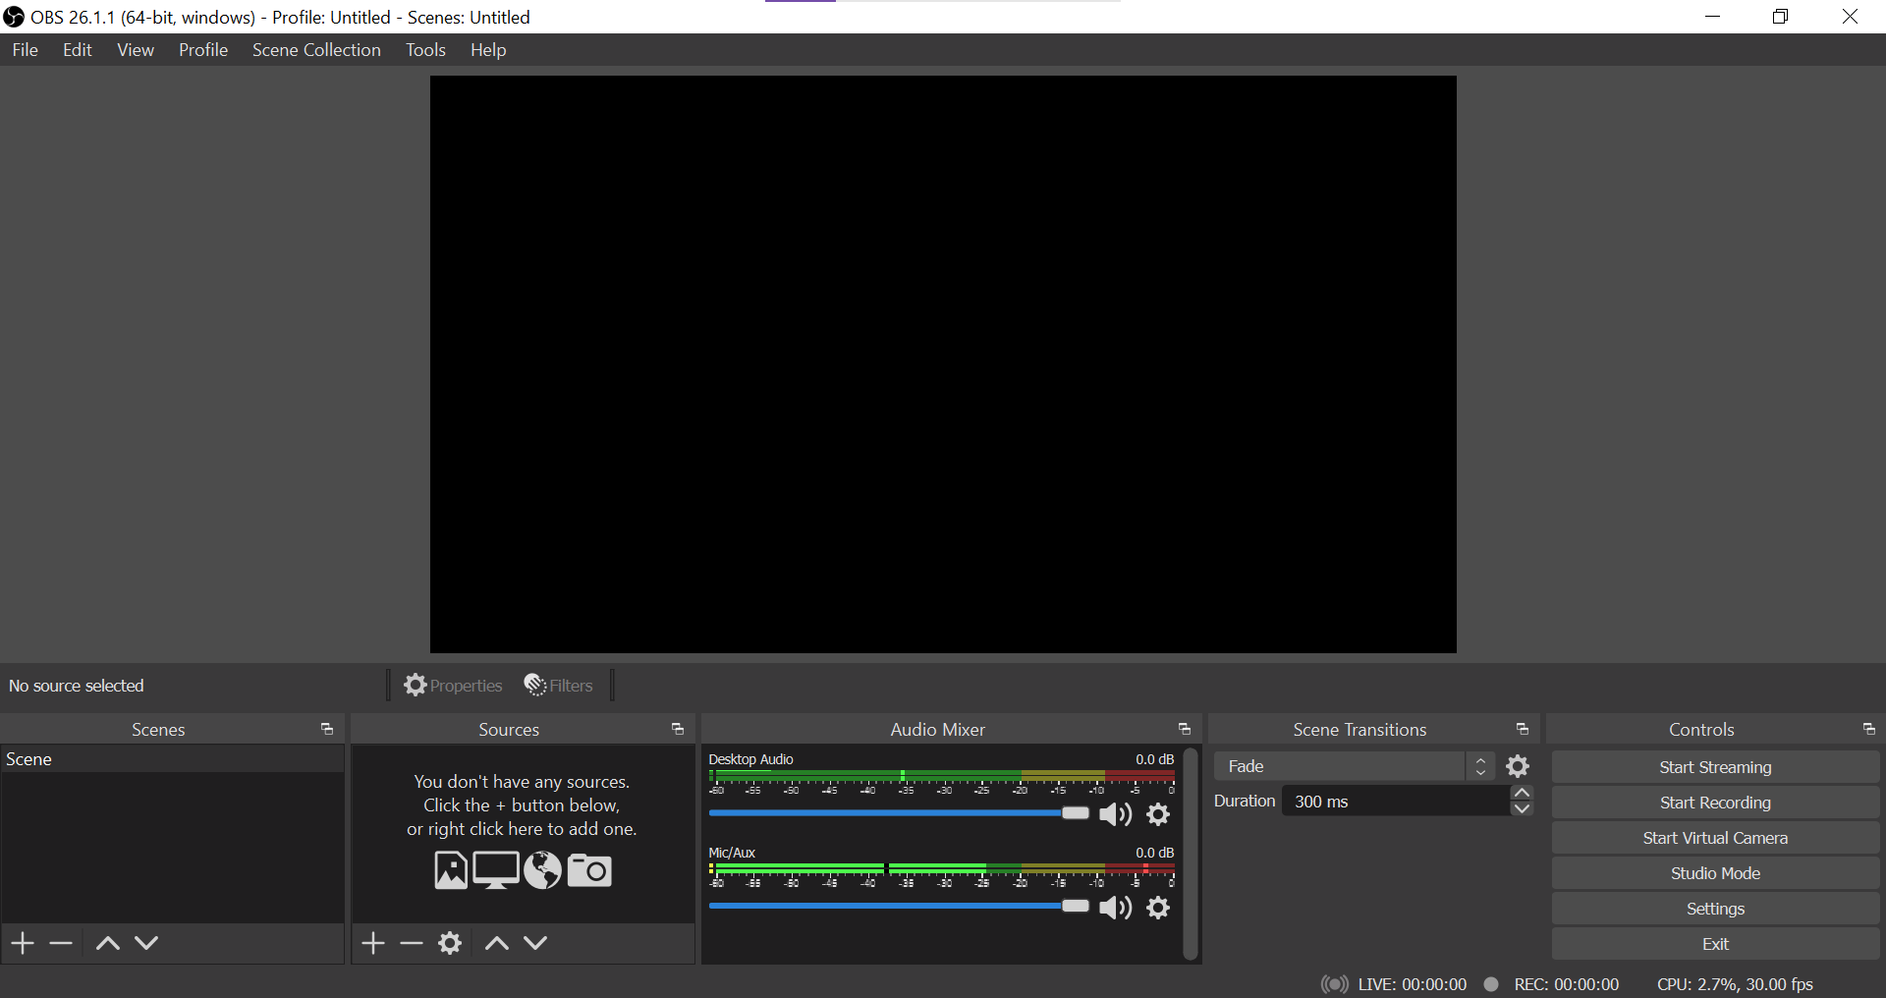
Click here to add a window capture
and choose chrome.exe (React app) and after that click on start virtual camera on the right bottom

Slide 35
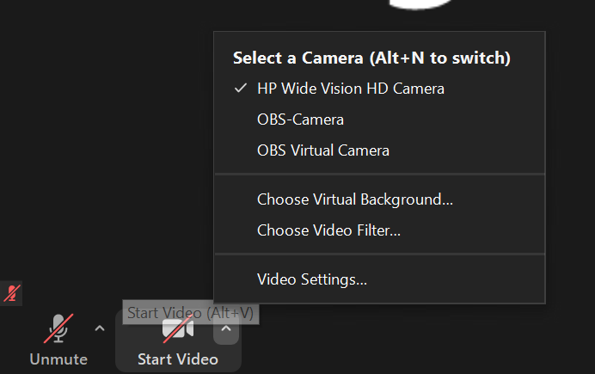
Once our virtual camera is ready, just open zoom meeting and choose virtual camera as an input for the video as show below:
Now you are good to go and use Smart Reactions in your zoom call.

Slide 36
Conclusion
This project can be used by anyone who wants a hassle free small communication in virtual meets. But, this is especially a boon for the people who can’t speak or can not listen. They can use this feature as a sign language detection app. For now we have added only one custom made sign language hand gesture and that is - ‘i love you’. We can easily add more in the future, which is our scope of improvement.

Slide 37
References
https://support.zoom.us/hc/en-us/articles/200912909-Getting-Started-With-Group-Messaging
https://docs.microsoft.com/en-us/microsoftteams/raise-hand-meetings
https://support.google.com/meet/answer/10159750?co=GENIE.Platform%3DDesktop&hl=en
https://techcommunity.microsoft.com/t5/microsoft-teams-public-preview/now-in-public-preview-meeting-reactions/m-p/1978451
https://support.zoom.us/hc/en-us/articles/360053176572-New-updates-for-December-21-2020
https://support.zoom.us/hc/en-us/articles/201361953-New-updates-for-Windows
https://obsproject.com/
https://github.com/tensorflow/tfjs-models/tree/master/handpose
andypotato/fingerpose: Finger pose classifier for hand landmarks detected by TensorFlow.js handpose model (github.com)

